Slide 1
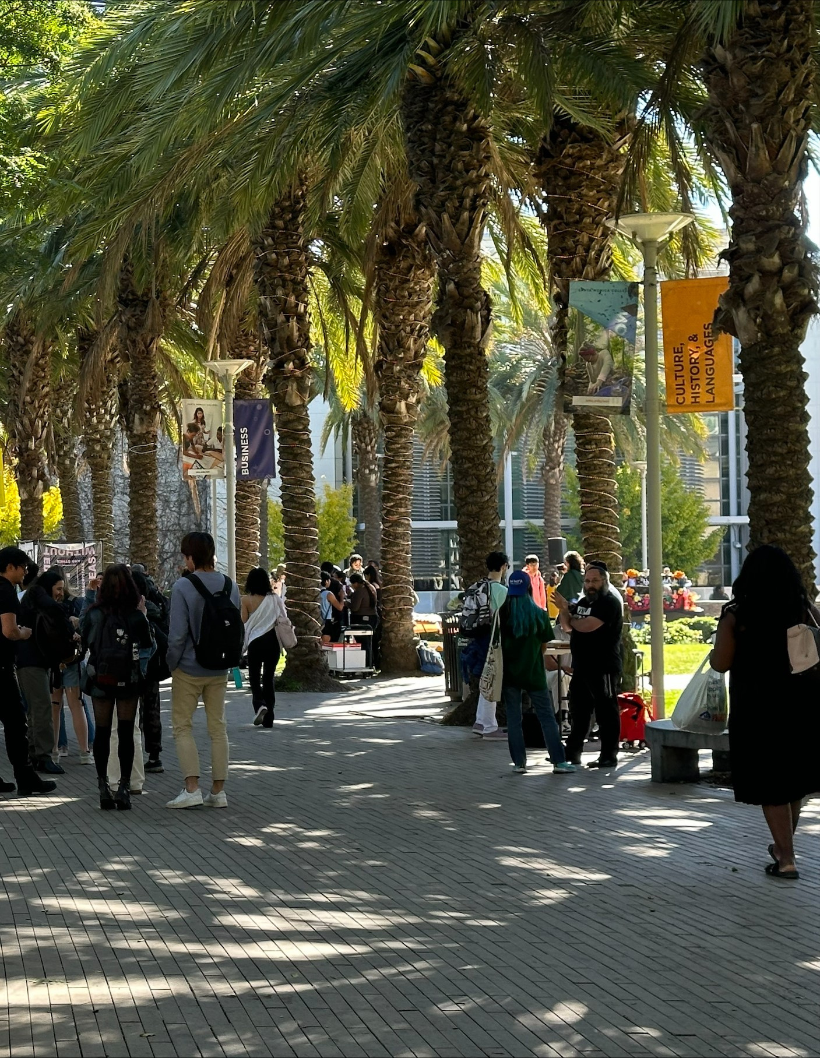

1
GRANT MANAGEMENT 101:
GETTING STARTED WITH AWARD MANAGEMENT
TRACY BEIDLEMAN, DIRECTOR OF GRANTS
SMC FOUNDATION GRANTS TRAINING 2024
Notes:
Good morning/afternoon everyone. First, congratulations on the new grant award. Grants like the one you have been awarded are an invaluable part of SMC’s vision to continue to be a leader and innovator in learning and achievement. We are happy to work with you to see your project through from beginning to end.
I am Tracy Beidleman, Director of Grants. I want to introduce myself and welcome you to the Getting Started with Grant Management Training. I joined the College in October 2021 to support Project Managers and prospective Project Managers with grant applications, submittals, and project management and currently assist with federal, state and local awards across campus.
As an award manager, you already know the organization, communication, and collaborative work involved in applying for an award. For many, you have been navigating the grant project management role for some time so this information may be a refresher. For those new to the project manager role, we hope this information provides a brief overview of the process and guidance on where you may seek additional support.
Now I am going to walk you through the next steps to successfully implement your grant award activities.
More detailed information can be found in the Grant Management Handbook which is provided to project managers upon notice of award and a link to the electronic book will be provided.

Slide 2
2
1
  Important Roles & Responsibilities
OVERVIEW
Award Implementation Process
2
The Notice of Award
  3
  Board of Trustees Approval
  4
  5
  Coordinating Personnel
  6
  Procurement System Set-Up
  Do’s and Don’ts for Success
  7
SMC FOUNDATION GRANTS TRAINING 2024
Notes:
Let’s get started with an overview of the information that will be presented today.
First, I will talk a little bit about the Award Implementation timeline and , then I will discuss the roles and responsibilities of Grant Managers and the departments that assist them throughout the grant's period of performance.
I will also explain the Board of Trustees Approval process, which must be completed before any project activities can begin. I will also highlight important steps to consider when coordinating with SMC personnel for hiring, maintaining the budget, and collecting and assessing data.
The training will review other aspects of early grant implementation like the procurement system set up and reporting.
Finally, this training will end with some helpful do’s and don’ts for successful grant management.

Slide 3





3
THE ROLE OF THE GRANT MANAGER:
The Grant Manager is the institution’s expert for this grant. While the Grants Office and Fiscal Services are available to assist, it is your responsibility to know the details of your grant and to ensure compliance with federal, state, local, and institutional rules, regulations, and requirements.
As Grant Manager, you are the primary liaison with the funding source, and it is very important that the funding source considers you their primary liaison.
If changes to the project work plan that will alter the scope or outcomes of the project need to be made, the Grant Manager, with the help of the Grant Team, must obtain official written approval from the funding source.
Sometimes the grant begins without the Grant Manager in place. That’s ok! The supervisor of the official Grant Manager is responsible for grant paperwork and activities until the Grant Manager is hired, although the Grants Office is available to provide this leadership and oversight upon request.
SMC FOUNDATION GRANTS TRAINING 2024
Notes:
The Grant Manager (sometimes called the Project Manager, Project Director, Principal Investigator) is the grant’s “go to” person for the grant.
The Grant Manager has two primary responsibilities:
Program Responsibilities – to ensure the project goals, objectives and outcomes are achieved on time; and,
Fiscal Responsibilities – to ensure the fiscal accountability of the grant – ensuring that the grant funds are expended according to the grant agreement
The Grant Manager’s role also includes:
Understanding and ensuring compliance with all rules and regulations of the grant
Acting as the primary point of contact with the funding source
Coordinating with the Grants Office and Fiscal Services through the life of the grant regarding scope changes, period of performance extensions and all reporting or other grant administration activities
Although faculty members often identify, write, and manage much of the grant work, an administrator is required for the day-to-day oversight of the grant funded program, including the regular project status and financial reporting as required. An administrator may include a project manager, a dean, a vice president or other district managerial role. The administrative personnel should have been identified during the Grant Approval Process phase of the proposal development.

Slide 4


4
PRIMARY RESPONSIBILITIES OF THE GRANT MANAGER:
Program Responsibilities – to ensure the project goals, objectives and outcomes of the grant award are achieved on time
Fiscal Responsibilities – to ensure the fiscal accountability of the grant expenditures according to the grant agreement
SMC FOUNDATION GRANTS TRAINING 2024
Notes:
The Grant Manager (sometimes called the Project Manager, Project Director, Principal Investigator) is the grant’s “go to” person for the grant.
The Grant Manager has two primary responsibilities:
Program Responsibilities – to ensure the project goals, objectives and outcomes are achieved on time; and,
Fiscal Responsibilities – to ensure the fiscal accountability of the grant – ensuring that the grant funds are expended according to the grant agreement
The Grant Manager’s role also includes:
Understanding and ensuring compliance with all rules and regulations of the grant
Acting as the primary point of contact with the funding source
Coordinating with the Grants Office and Fiscal Services through the life of the grant regarding scope changes, period of performance extensions and all reporting or other grant administration activities
Although faculty members often identify, write, and manage much of the grant work, an administrator is required for the day-to-day oversight of the grant funded program, including the regular project status and financial reporting as required. An administrator may include a project manager, a dean, a vice president or other district managerial role. The administrative personnel should have been identified during the Grant Approval Process phase of the proposal development.

Slide 5

5
GRANT MANAGEMENT SUPPORT
Grants Office:
Provides technical assistance to Grant Managers throughout the life of the grant and will assist with continuation applications and/or new funding as needed
Institutional Research:
Assists with identifying an external project evaluator if necessary and/or collecting and assessing grant related data requirements
Grant Manager:
(Also referred to
as the Project Manager,
Project Director,
or Principal Investigator)
Fiscal Services:
Reviews and processes all grant expenditures and assures that the grant remains compliant with internal and external audit requirements
Procurement, Contracts, & Logistics:
Obtains materials, equipment, and services in compliance with California state statutes and College policies
Program Officer:
The college’s primary point of contact with the funding source
SMC FOUNDATION GRANTS TRAINING 2024
Notes:
Although Grant Managers are the grant experts, they have a robust support system to ensure the project outcomes of the award are achieved.
Review the roles in the bubbles:
The Grants Office
Fiscal Services
Program Officer
Procurement, Contracts, and Logistics
Institutional Research

Slide 6
6
AWARD IMPLEMENTATION FLOW:
REVIEW YOUR AWARD
AGREEMENT & GRANT
APPLICATION
OBTAIN BOARD OF TRUSTEES APPROVAL
IDENTIFY & MEET WITH YOUR ACCOUNTING MANAGER IN
FISCAL SERVICES
REVIEW PERSONNEL PLAN & INITIATE HIRING PROCESS
COMPLETE REQUISITION PROCESS FOR
ALL PURCHASE ORDERS
INITIATE GRANT WORK AND ACTIVITIES
SMC FOUNDATION GRANTS TRAINING 2024
Notes:
This sequence of activities for the implementation of your award begins with a careful review of your original application and the award agreement. Reviewing these documents helps to ensure you understand all policies and procedures and to confirm the scope of the grant and expected performance measures and outcomes in the application and the grant award are consistent.
As soon as possible, you should begin to prepare for the Board of Trustees Approval as you will not be able to begin award activities until approval. Part of this preparation will include meeting with your Accounting Manager in Fiscal Services so they can help you with some of the necessary documents, which I will explain later in this presentation.
It is important to note that, while this chart shows a linear progression of activities, the reality of grant management is that some of these activities will happen concurrently. In other words, it is often the case that meetings and planning will overlap and will be ongoing.
Once you have received Board of Trustees approval, you can begin your hiring, purchasing, and grant implementation activities.

Slide 7

NOTICE OF AWARD
7
This is the official document needed to greenlight spending and develop your acceptance memo to the board of trustees for approval.
  What is the grant number? (You will need to include this number on all communications with the Program Officer.)
  What is the name and phone number of the funding source’s Program Officer?
  What are the reporting requirements?
  Is there a separate contract that outlines the responsibilities of grantee and grantor included with the award notice?
SMC FOUNDATION GRANTS TRAINING 2024
Notes:
As I explained, familiarizing yourself with the details found in the notice of award is a crucial first step in grant implementation. A grant is a legal contract between the funding agency and the District and your award notice is the official document needed for Board of Trustees approval. It also contains easily accessible and important basic information like:
The grant number
The contact information of the funding source’s Program Officer, and
Reporting requirements

Slide 8

8
BOARD OF TRUSTEES APPROVAL
Before beginning your grant award activities, the grant award must be approved by the SMC Board of Trustees. Necessary documents include:
1
2
3
AGENDA ITEM TEMPLATE
GRANT AWARD NOTICE
SUBMITTED APPLICATION
Submit acceptance memo to fiscal services
Grant number and award amount
Project description and timeline
4
5
6
COMPLIANCE GUIDANCE
APPROVED BUDGET
SUPPLEMENTAL SUPPORT DOCUMENTS
Reporting and other funding source requirements
Confer with your grant accountant in Fiscal Services
Examples include collaboration or subaward documents
SMC FOUNDATION GRANTS TRAINING 2024
Notes:
I have already mentioned that Board of Trustees approval is necessary before any grant activities can be initiated. Now I would like to walk you through the process in greater detail and go over the documents needed for approval.
Information for the BOT package includes:
• BOT Agenda Item Template (this is the acceptance memo that is submitted to the Board for your award). The acceptance memo provides an overview of the grant award including the funding totals (one year or multi-year) and highlights the purpose of the award. Included with the acceptance memo are:
• Official Grant Award Notification with Award Amount
• Submitted Application
• Project Description (detailed)
• Approved Project Budget and Justification
• Award Reporting and Compliance Requirements
• Supplemental Support Documentation
A template sample can be found in the Appendix of the Grant Managers Handbook.
After preparing the package, the BOT Agenda Template should be signed by your area vice president. Once signed, all award documents should be forwarded to the Fiscal Services Office to the attention of the Accounting Manager. The Accounting Manager will then review the documentation for thoroughness and may contact you for additional information or clarification.
Be sure to note the Board of Trustees meetings and the due dates for submitting agenda items so that it is completed and submitted on time. Generally, documentation is required to be submitted to the Fiscal Services Office 3-4 weeks prior to the upcoming board meeting. A sample of due dates can be found in the Grant Managers Handbook Appendix, and you may reach out to Fiscal Services for specific due dates to their office.
Connecting with your Grant Accountant in the Fiscal Services Office as you begin to prepare the Agenda Template is imperative. You will need to assign the correct accounting codes to the planned expenditures that will be included in the BOT Acceptance Memo. There is a Chart of Accounts provided by the Fiscal Services Office and included in the Appendix Section of the Grant Manager’s Handbook. Please work with your assigned Grant Accountant to ensure accuracy.
Concurrently, while preparing the package for presentation to the BOT for approval, you should work with the Fiscal Services office to set up the person(s) who will be responsible for submitting requisitions in the BEST Accounting System. This may be a Project Manager, Grant Manager, Administrative Support or other support personnel. Fiscal Services will request this information from you in order to have processes in place once the Board of Trustees approves your grant award.

Slide 9
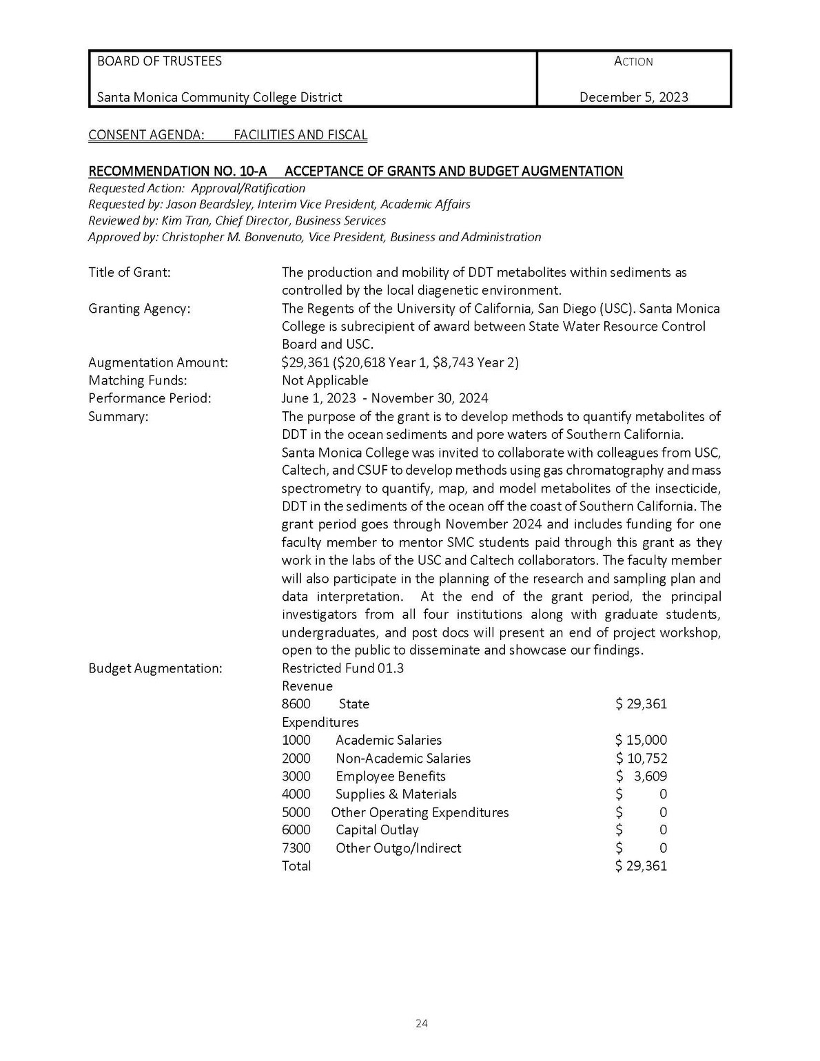





COMPLETING THE AGENDA ITEM TEMPLATE FOR BOT APPROVAL:
9
1. Date that your award will be included on the BOT agenda
2. Your area Vice President, Director of Business Services, and Vice President of Business and Administration
3. The title of the grant, granting agency, amount of award, and perfomance period
4. A brief summary detailing the purpose of the grant
5. Expenditure code details
SMC FOUNDATION GRANTS TRAINING 2024
Notes:
The notice of award will help you begin to complete the acceptance memo.

Slide 10

10
COORDINATING GRANT ACTIVITIES
SMC FOUNDATION GRANTS TRAINING 2024
Notes:
Coordinating your grant management activities involves establishing or continuing relationships and protocol with the various SMC departments that will help you throughout the life of your grant, including Human Resources, Financial Aid, Fiscal Services, and Institutional Research.
The following slides will detail how to begin hiring, purchasing, collecting data, and initiating all other grant activities.

Slide 11

11
Identify staff hiring as approved in grant award
  Complete the Personnel and Budget Augmentation Request (PBAR) Form to begin the hiring process
  Track time and effort reporting, which documents the amount of time that each staff person spends working on a particular project
SMC FOUNDATION GRANTS TRAINING 2024
HUMAN RESOURCES
Notes:
You will want to coordinate with Human Resources early in the process. If your grant requires the hiring of a project manager, this process may take time. Please note that project manager positions are temporary in nature and are based on the needs of the specific grant award.
If you are seeking classified staff, you will need to coordinate with the Personnel Commission. Since classified staff are considered permanent, and the grant has a period of performance ending date, you will need to discuss what was budgeted in the grant and how to accomplish your personnel needs.
In addition to project managers, Faculty who may be serving as principal investigators may be seeking release time or stipends during the grant period. You will need to coordinate with your area vice president or grant administrator.
For student workers that may be hired for the project activities you will coordinate with the Office of Financial Aid.
Please note that for persons working on the grant, you will need to ensure that Time and Effort Reports are completed and submitted to the Fiscal Services Office.
Time and effort reports are required for all staff who work on the project, including salaried employees, hourly assistance, student workers, and in-kind volunteer support.
These reports account for the time expended on grant activities by the budgeted personnel. Additional information is included in the Grant

Slide 12
12
Identify student worker hiring as approved in grant award
  Review rules and limitations for federal work-study student workers and student help student workers
  Complete an online Student Worker Request Form at: https://www.smc.edu/admission-aid/financial-aid-scholarships/types-of-aid/student-employment/student-worker-request.php
SMC FOUNDATION GRANTS TRAINING 2024
FINANCIAL AID
Notes:
As I just mentioned, if you are seeking a student worker you will need to work with the Office of Financial Aid. They have an online Student Request form that must be completed. The website is noted on the slide here. Please contact them for more information.

Slide 13
13
  Determine accuracy of the budget, with the help of the grant accountant
  Develop two budgets for each account code—one that adheres to the line items identified by the funding source and another that follows the institutional format
  Monitor both budgets, including time and effort reporting and all other expenditures
SMC FOUNDATION GRANTS TRAINING 2024
FISCAL SERVICES
Notes:
Of course, you will already have been communicating with Fiscal Services by the time you receive Board of Trustees Approval. But your Grant Accountant will continue to assist you with maintaining an accurate budget.
Also, it is essential that the Grant Manager understands the differences between the budget that is included in the grant application and reported to the Program Officer and the budget that is submitted to the College’s Fiscal Services Office and included in the College’s annual operating budget. It is the Grant Manager’s job to monitor both budgets.
As I mentioned a moment ago, a part of the budget monitoring includes time and effort reporting. This is one of the most important responsibilities a Grant Manager has as it is important that those working on a project are fairly and adequately compensated.
Time and effort reports document the amount of time that each staff person spends working on a particular project and compare this time allocation with the amount of time stated in the individual’s contract and billed to the funding source Please work with Fiscal Services regarding these reports.

Slide 14
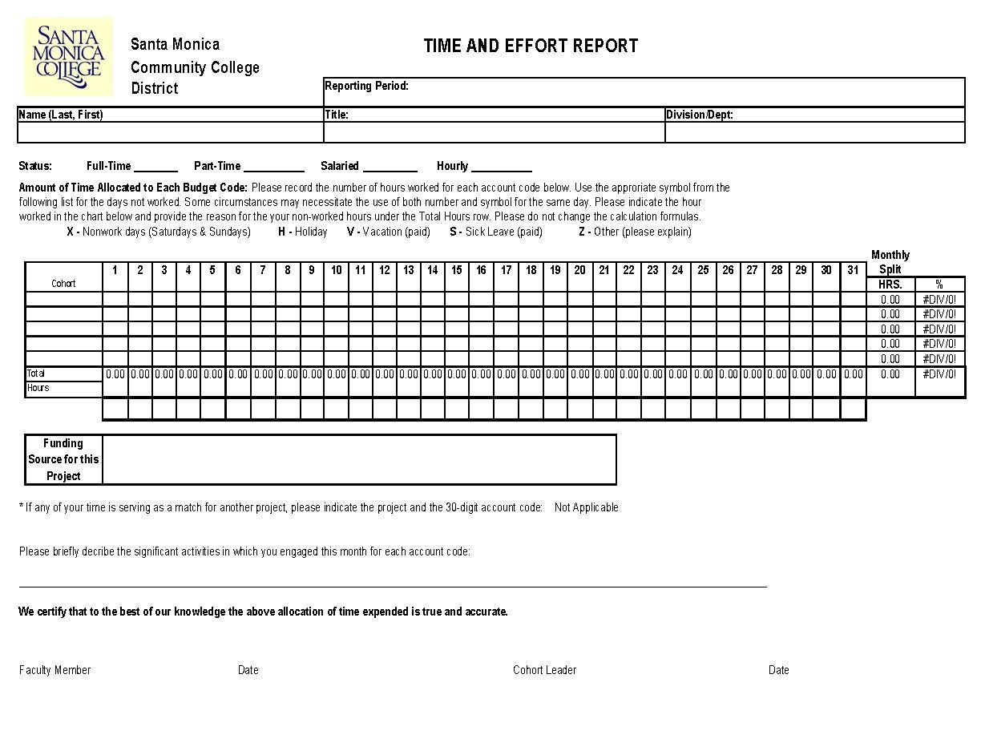
14
Tracking Time & Effort
  Does the time allocation billed in the report align with the time stated in the individual’s contract?
  Does the report accurately reflect the work performed?
  Are reports submitted and maintained in a timely manner?
SMC FOUNDATION GRANTS TRAINING 2024

Slide 15
15
Work with the Grant Administrator and the Office of Institutional Research to identify an external evaluator for your activities
One of the best resources for finding qualified evaluators locally, regionally, or nationally is the Evaluation Center at Western Michigan University (https://wmich.edu/evaluation)
Obtain quality, accessible, and relevant data, research, and tools for grant related data requirements with the help of the Office of Institutional Research
INSTITUTIONAL RESEARCH
SMC FOUNDATION GRANTS TRAINING 2024
Notes:
Your grant may require a grant evaluator which may or may not have been budgeted in your grant proposal. Please work with the Office of Institutional research to assist you with your data needs and project evaluator needs.
One of the best resources for finding qualified evaluators locally, regionally, or nationally is the Evaluation Center at Western Michigan University (https://wmich.edu/evaluation )
Please review the Grant Management Handbook for additional details.

Slide 16
16
PROCUREMENT SYSTEM TRAINING
SMC FOUNDATION GRANTS TRAINING 2024
Notes:
One of the steps to implementing your project is initiating purchases for awarded equipment, services, or other project activities. The Grant Manager must authorize the purchase of resources necessary to implement these activities. Let’s walk through how this is done.

Slide 17
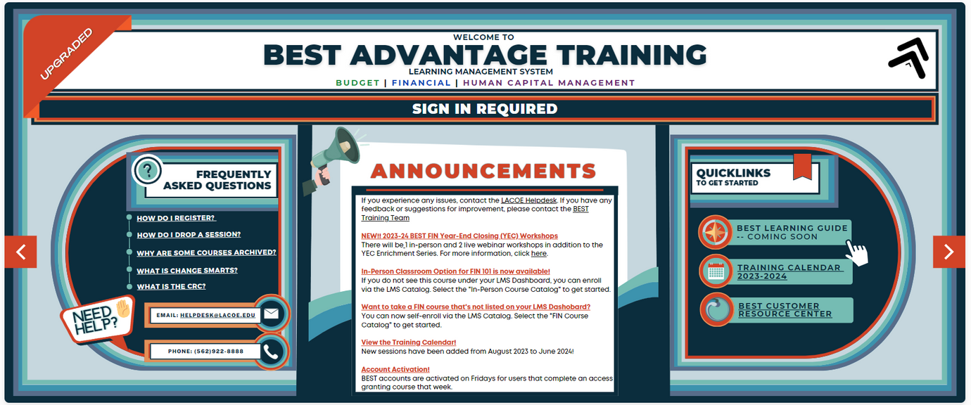
17
BEST Accounting System:
The person who will be entering requisitions for the grant must be an authorized user in the BEST Accounting System.
If the person is a new user they will need to complete training in the system prior to full approval and authorization in the system.
SMC FOUNDATION GRANTS TRAINING 2024
Notes:
BEST (which stands for Business Enhancement System Transformation) is the system used to purchase all services and equipment and requires authorized purchasers to complete an online training course before they are approved to use the system.
As already mentioned, as you prepared your Board of Trustees acceptance memo and provided all of the supporting documentation, you will also provide the names of the persons who will be responsible for submitting requisitions in the BEST System, approving the requisitions and approving the invoices.
If you are new to the BEST System, the first step will be to attend the required training. After the training you will be granted access to the system for activities related to purchases needed for your grant.
Often the Project Manager of Co-PI is responsible for submitting the requisition and coordinating with the direct supervisor, grant administrator or Area Vice President to approve the requisitions and the invoices.
You will coordinate directly with Fiscal Services for questions regarding the BEST System and the Procurement, Contracts and Logistics Office for purchasing questions.

Slide 18
18
THE REQUISITION PROCESS
WHO SUBMITS A REQUISITION?
  GRANT MANAGER
  LEAD ADMINISTRATOR/MANAGER
  ADMINISTRATIVE ASSISTANT
WHO APPROVES A REQUISITION?
  DIRECT SUPERVISOR
  ADMINISTRATOR
  AREA VP
  ACCOUNTING
WHO APPROVES AN INVOICE?
  GRANT MANAGER
  ADMINISTRATOR
  AREA VP
SMC FOUNDATION GRANTS TRAINING 2024
Notes:
These are a few important questions you should be able to answer about your required grant reports.

Slide 19
19
REPORTING:
SMC FOUNDATION GRANTS TRAINING 2024
Notes:
Another important responsibility the Grant Manager has is reporting successes and challenges in meeting the project’s goals.
As we have discussed, the funding source will outline its reporting requirements in the award letter, the attached contract, and/or in follow-up correspondence. It is the Grant Manager’s responsibility to complete and submit these reports on time.
Depending on your grant program, reporting may be quarterly, semi-annually or annually. You will need to know this information to ensure compliance.
Fiscal Services has also implemented an internal grant reporting submission process to ensure all regulations and requirements are followed when submitting to a granting agency. As a part of the process, the Project Manager will send a draft of the completed report to the grant Accountant along with ledgers and any additional support files related to metric reporting. The assigned Grant Accountant will confirm that the expense and budget numbers reflected on the report match the District ledger and will forward the expense/performance report along with ledgers and any Institutional Research data files to the Accounting Manager for review and upon approval will forward to the VP of Business and Administration for approval sign-off.
These review activities should happen before you, as the project manager, submit the reports to the grant sponsor agency.
Please refer to the Grant Reporting Submission Process and Policy document in the Grant Management Handbook for detailed guidelines.

Slide 20
20
KNOW YOUR REPORTING REQUIREMENTS
IS YOUR REPORTING TIMELINE QUARTERLY, SEMI-ANNUAL, ANNUAL?
WHAT FORMAT IS REQUIRED FOR THE NARRATIVE TO SHARE THE SUCCESSES AND CHALLENGES OF THE PROJECT?
WHAT IS REQUIRED IN THE FISCAL REPORTS?
SMC FOUNDATION GRANTS TRAINING 2024
Notes:
These are a few important questions you should be able to answer about your required grant reports.

Slide 21
21
Be Audit Ready at All Times!
This means reviewing the budget each month with the Grant Accountant so that you can catch mistakes before they become difficult to fix including:
Expenses accidentally charged to the wrong account
An encumbered expense that is significantly more or less than the actual expense
An encumbered expense that is never charged to the grant
An actual expense that was not approved by the Grant Manager
Salary expenses that seem too high or too low
SMC FOUNDATION GRANTS TRAINING 2024
Notes:
Finally, you always want to “BE AUDIT READY.” That means communicating with your Grant Accountant and keeping them informed on all correspondence involving fiscal or budget issues throughout the life of the grant.
Also, that means keeping thorough records of transactions, reviewing your budget and expenditures monthly and meeting regularly with your Grant Accountant to review your expenditures.
Slide walk through

Slide 22
22
DO’S AND DON’TS FOR SUCCESS:
SMC FOUNDATION GRANTS TRAINING 2024
Notes:
Transition.
Now as we close, we just want to share a few Do’s and Don’ts to assist you in your role as project manager.

Slide 23


23
Do’s
Don’ts
Carefully read all correspondence from the funding source; pay attention to due dates and prioritize grant tasks
Don’t lobby, don’t politic, don’t entertain, and don’t support religious activities. Each of these activities is strictly prohibited by nearly all funding sources
Keep up with budget; the college will be held accountable for your stewardship
Don’t purchase from or award contracts to relatives and friends
Ask questions and utilize all members of your Grant Team. The sheer volume of information can be daunting
Don’t use grant funds to supplant existing resources, meaning you cannot use grant funds to pay for existing costs that would otherwise be paid by the college
SMC FOUNDATION GRANTS TRAINING 2024
Notes:
Review dos
Review don’ts
A few words about supplanting: In nearly all circumstances, grant funds cannot supplant existing resources, meaning that you cannot use grant funds to pay for existing costs that would otherwise be paid by the College.
In other words, grants cannot underwrite the costs of current operations!

Slide 24

24
For more detailed guidance, please refer to the SMC Grant Management Handbook:
Link to the Grant Management Handbook can be found here
Or, contact the SMC Grant Office with any questions
SMC FOUNDATION GRANTS TRAINING 2024
Notes:
As we close, this training was meant to give you an overview of grant implementation in your role as project manager.
For more detailed information, please refer to the Grant Management Handbook located in the link here or reach out to the Grants Office.

Slide 25





25
THANK YOU!
310-434-4180
www.smc.edu/grants
beidleman_tracy@smc.edu
Foundation Office
1516 Pico Boulevard, Santa Monica
Notes:
Thank you for attending and please feel free to reach out via email or phone with any questions.

