Slide 1
StudentLingo www.smc.edu/StudentLingo
StudentLingo Online Workshops:
Tools for the Entire SMC Community
Department Chair’s Meeting– June 1, 2018
Santa Monica College
Latino Center
Maria Martinez - Veronica Castillo
Notes:
We want to introduce you to this very useful online resource available to ALL of us and our students: StudentLingo provides online student success video workshops that can be accessed by anyone affiliated with SMC—student, faculty, staff, parent,—24/7.
Originally, through funds from a GRIT grant, the Latino Center piloted use of 4 of these workshops with Adelante Program students, and found a strong positive student response to these workshops. Students were also asking for more workshop topics.
We wanted to provide more and offer additional resources to students and faculty.
The SMC Foundation provided the funds to get all 48 workshops through July 2020.
Our role is to inform others of this resource available to the entire SMC community, help build use throughout our campuses,
and be able to show by the time we need to renew the contract, that this is a well-used resource.

Slide 2
OVERVIEW
  Key Features of StudentLingo
  Content & Samples
  Latino Center Experience
  Suggestions for Use
Notes:
Read list

Slide 3
LOOK FAMILIAR?
What new ideas and new materials can I use to enhance our classes?
How can we use technology to increase student support and resources?
How can I increase student participation in program or classroom activities?
What additional resources can we make available to our faculty in and outside of the classroom?
What additional resources can help us promote equity?
…and I DON’T want to reinvent the wheel!
Notes:
You might have asked yourselves similar questions about your class or department.
Basically, how can we make resources more accessible to our students and faculty without reinventing the wheel?

Slide 4
Notes:
There are 48 online videos which include activities and additional online resources.
Ex. Reading Comprehension, How to Overcome Math Anxiety, How To Develop Your Cross-Cultural Skills
This variety helps in increasing the capacity to address multiple student or classroom needs.

Slide 5
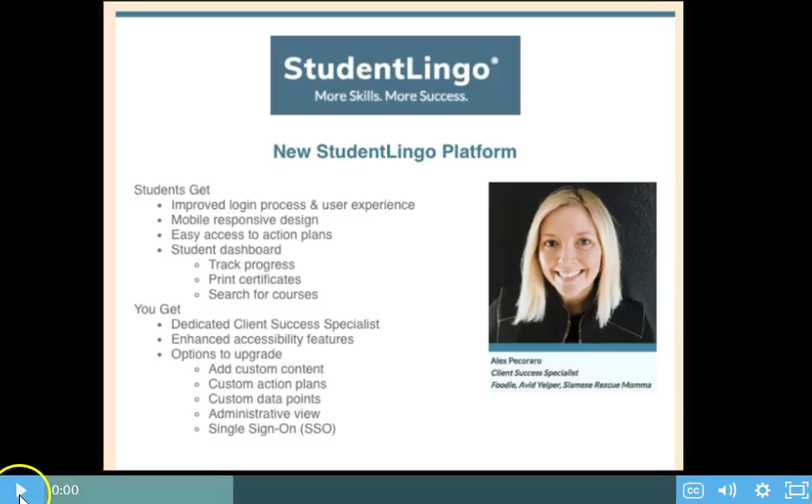
StudentLingo PLATFORM
Notes:
We gained access to the 48 workshops last Fall, which is also when StudentLingo’s platform was updated and new features were added.
Alex is our liaison and created this 4-minute video which will give you a quick intro to the look and feel of StudentLingo.

Slide 6
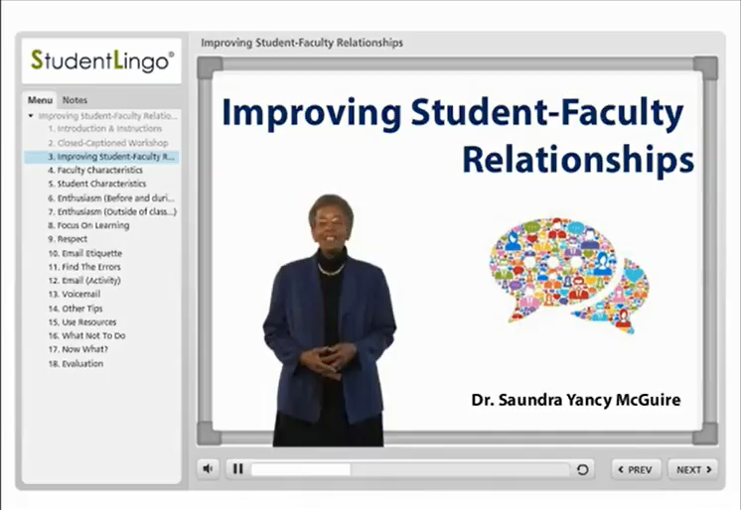
SAMPLE WORKSHOPS
Classroom Topics:
Notes:
Student-Faculty Relationships
Reading Comprehension
Pre-writing Techniques

Slide 7
PRACTICAL & ACCCESSIBLE
Available on-demand, online, 24/7
Mobile responsiveness gives added flexibility
Users can track their progress
Fillable PDF forms can be saved & sent electronically
ADA compliant, offering closed-captioning & transcripts
48 workshops broken into small segments & activities
Options for verifying workshop completion
Can be used in or out of class
Increases access to online student support
Unlimited institutional access to this resource
Entire SMC community can benefit!
Notes:
You can start to see how this would be a practical and accessible resource.
I want to point out the ADA compliance that’s built in, being able to track your progress in a workshop, as well as the increased access to online student support that is available to students, AND faculty and staff.

Slide 8
SPEAKING OF EQUITY…
FOR STUDENTS:
Greater flexibility in accessing an important resource
Can offer added support to all students in and out of class
Creates opportunities for dialogue between students and faculty/staff
Skills and insight can help empower students
FOR FACULTY & STAFF:
Can extend ability to address topics we’re less familiar or comfortable with
Refresh or enhance skills and knowledge that inform your work
Extend our reach to all students when we don’t have the class/office time
Further empowers faculty & staff to address multiple student needs/ challenges
Notes:
As our SMC community increases its focus on equity, we view this as a good tool that can help EMPOWER students… AND faculty and staff.
This resource can help facilitate important conversations and increase our abilities to support students.

Slide 9
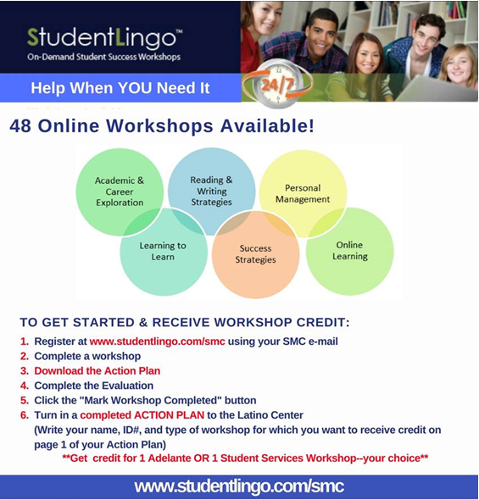
LATINO CENTER EXPERIENCE
Notes:
This is the flier sent to Adelante students last Fall with instructions on how to get workshop credit. Last semester we offered all 48 workshops.
You have the new fliers that provide more information about the workshops and how to get started
Our students must complete two workshop activities, and one of them may be from the online workshop menu.
We require a completed Action Plan for a workshop to receive credit, rather than a Certificate of Completion.
You can choose how you want to verify the workshop completion.

Slide 10
What we found…
FALL 2016: FOUR WORKSHOPS AVAILABLE
10 Habits of Mind for College Success
Learning Strategies Every Student Should Know
Reading Comprehension Strategies
Time Management Strategies for Success
306 Workshop Views (about 2 per participant, N=178)
171 Surveys: 57% rated workshops Excellent, 32% Very Good
79% of Surveys stated preference for Online/On-Demand workshops
% Enrolled Adelante students submitting a completed Action Plan - 16% (122/754)
FALL 2017: ALL 48 WORKSHOPS AVAILABLE
*multiple views of one workshop by same participant are no longer recorded
512 Workshop Views* (about 2 per participant, N=289)
322 Surveys: 59% rated workshops Excellent, 33 % Very Good
29% surveyed prefer Online/On-Demand, 64% like having both face-to-face & online
% Enrolled Adelante students submitting a completed Action Plan – 27% (241/892)
Top 5 Unduplicated Views: Time Management, Mental Health & Suicide, Stress Management, Online Courses: Staying Motivated, How to Succeed in Math, Financial Literacy: Smart Money Skills
Notes:
We initially started w/ 4 workshops and got some really good feedback from students. (Point out some results)
Last summer, the SMC Foundation stepped up to fund these workshops through July 2020 so that SMC could really experiment with these and take full advantage of this resources. The feedback and participation we’ve continued to receive is very encouraging.
Sign of the times….Point out Top 5 Viewed

Slide 11
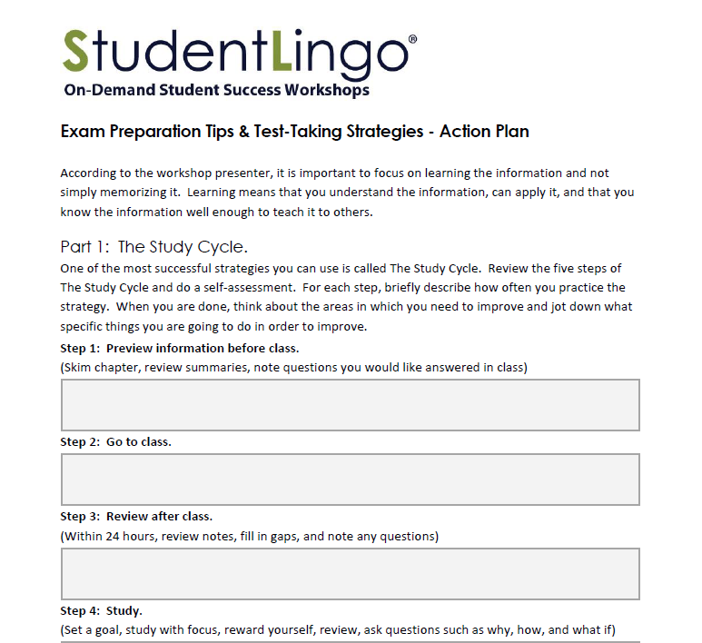
Notes:
Action Plan in handouts

Slide 12
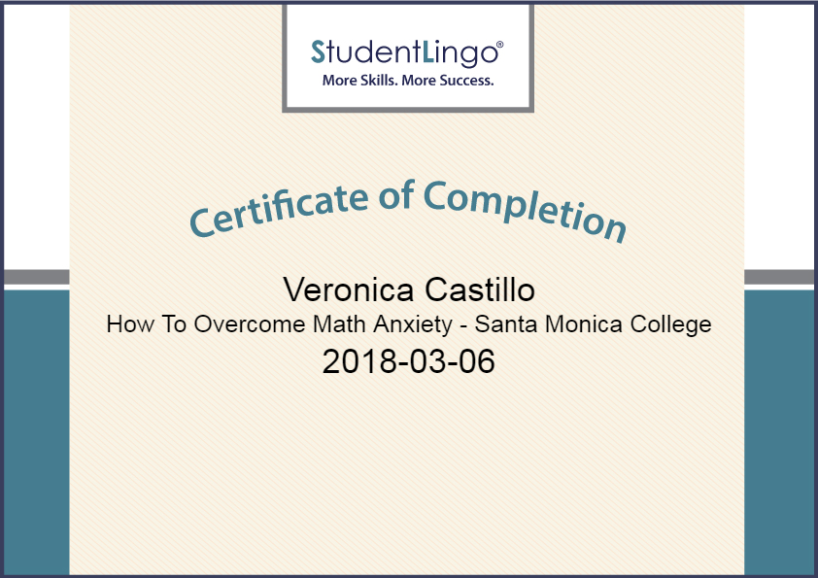
Notes:
Certificate of Completion Example

Slide 13
IDEAS
Include SL website on your syllabi & Canvas shells
Play workshops or StudentLingo PowerPoints in waiting areas (we can provide PPT and digital flyers)
Assign SL workshops/Action Plans for extra credit, group work, class activity
Use SL to teach additional skills that support their success in your class (Ex. Reading Comprehension, Classroom Expectations)
Recommend workshops during one-on-one time to address student needs
Complete a workshop that helps you address a topic you wish you were a little more comfortable addressing with students (Ex. Come away with one strategy or idea that’s helpful)
Encourage or require students to view workshops on reducing test anxiety and exam preparation before exams or mid-terms and finals
Work with Institutional Research to develop small pilot programs or interventions using StudentLingo
(Adapted from 10 Ways Faculty Can Support Students’ Success Using StudentLingo!, Innovative Educators, 2017)
Notes:
So, how can I apply this tool in my class or program?
How can I try to empower myself and my students?
Here are some concrete examples.

Slide 14
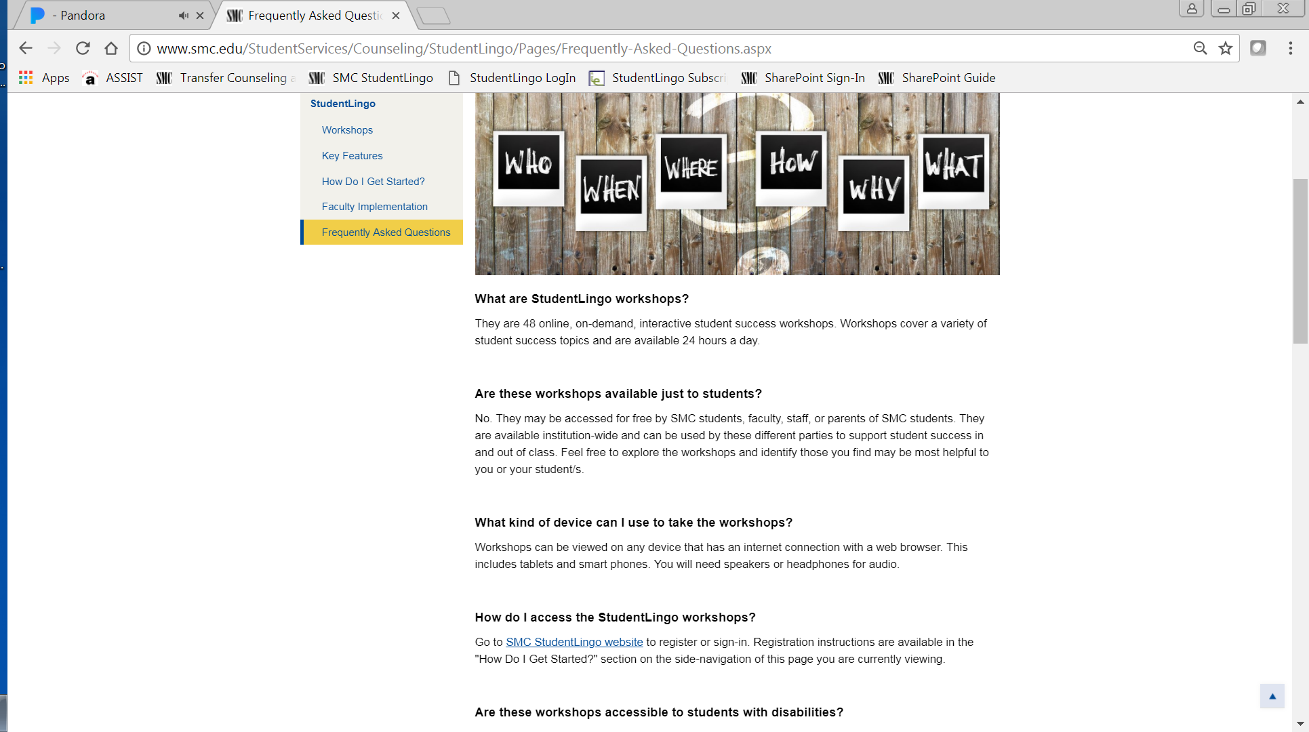
Go to www.smc.edu/StudentLingo
Also on the “SMC GO” App!
Notes:
Our Media and Web Services Division helped us create SMC web pages to provide more specific information about StudentLingo.
You can see the main topics listed here on the left.
In particular, you’ll want to check out the bottom three links. And please let us know if you have feedback about the information available on this site.
The SL link is now also on the SMC GO app, so students have yet another link to access these resources.

Slide 15
HOW DO I GET STARTED?
Go to www.studentlingo.com/smc 24/7/365
Register/Sign-In with your SMC e-mail
Answer three mandatory SMC questions:
  SMC ID# (Faculty/Staff: Enter a “0” as their SMC ID#,
  Parents of SMC students: Enter “2” as their ID #)
  Where/how did you hear about StudentLingo workshops? (Ex. SMC website, Couns 20, flyer, Adelante, English professor)
  Please select your affiliation with Santa Monica College: (Student, Faculty, Staff, or Parent)
Browse and choose a workshop!
Notes:
From wherever you are—computer, tablet, or other mobile device--access the SMC portal through this site and follow these steps.

