Slide 1
Equity in Faculty Hiring
December 1, 2017

Slide 8
`

Slide 17
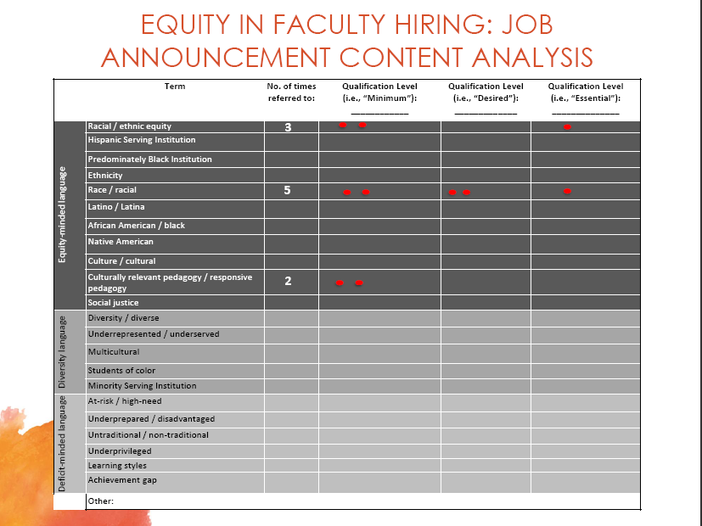

Slide 18
Equity Minded Language
Racial/ethnic equity
Hispanic Serving Institution
Ethnicity
Race/racial
Latino, Latina, Latinx
African American/Black
Native American
Asian Pacific Islander
Culture/Cultural
Culturally relevant pedagogy/responsive pedagogy
Social Justice

Slide 19
Diversity Language
Diversity/diverse
Underrepresented/underserved
Multicultural
Students of Color
Minority Serving Institution

Slide 20
Deficit-minded language
At-risk/high-need
Underprepared/disadvantaged
Untraditional/non-traditional
Underprivileged
Learning styles
Achievement Gap

