Slide 1
Santa Monica College
Third Quarter Budget Report
Board of Trustees
May 4, 2021

Slide 2

Pandemics Effect on District Finances

Slide 3
What Are The Sources of Revenue for the District?
Student and State Driven Sources of Revenue
  Apportionment: $134,506,494
  Non-Resident Tuition: $24,028,370
  Lottery: $3,353,462
  Student Fees: $1,227,212
  Mandated Cost Reimbursement: $592,762
Total Student and State Driven SoR: $163,704,300
Other Sources(rent, interest, etc.): $12,178,675
Student and State Driven SoR are 93.1% of Total Revenue!!!!
Take Away: Enrollment and the State Financial Situation Drives The Majority of Districts Revenues!!!!!

Slide 4
District Enrollment

Slide 5
Credit Resident Enrollment and COVID
Resident enrollment drives 76.5% of revenue
2018-2019 Final: 19,501 Credit FTES
2019-2020 Adopted Budget: 19,733 Credit FTES
2019-2020 P1: 19,736 Credit FTES
2019-2020 Final Actual: 17,551 Credit FTES
For 2019-2020 Emergency Reporting was initiated by CCCOO
  Allowed reported FTES at P1 levels with adjustment
2020-2021 Adopted Budget: 18,938 Credit FTES
2020-2021 P2: 19,101
<2.1%> Less Credit Resident FTES than pre-pandemic

Slide 6
Non-Resident Enrollment and COVID
Second largest source of revenue
  Almost 8 times larger than next largest source of revenue
2018-2019 = 4,259 Non-Resident FTES
2019-2020 Final Actual: 3,702 Non-Resident FTES
  <13%> decline in Non-Resident FTES from PY
2020-2021 P2: 3,195 Non-Resident FTES
  <13.7%> decline in Non-Resident FTES from PY
Since the start of the pandemic:
  <1,064> or <24.9%> decline in Non-Resident FTES
2021-2022 Preliminary Projection: 2,742 Non-Resident FTES
  <1,517> or <35.6%> decline in Non-Resident FTES

Slide 7
Non-Resident Enrollment and COVID
    2018-2019 Final NRT Revenue = $33,029,528
    2019-2020 Final NRT Revenue = $28,384,549
    2020-2021 Projected NRT Revenue= $24,028,370
    Pandemic related annual decrease of ~<$9,001,158>
    2021-2022 preliminary projection = $20,557,609
    Pandemic related annual decrease of ~<$12,471,919>

Slide 8
FTES Decline Since The Pandemic
2018-2019: 23,760 Credit and Non-resident FTES
2020-2021: 22,296 Credit and Non-resident FTES
<1,464> FTES decline or <6.1%>

Slide 9
Source: Ed Source and California Community College Chancellor’s Office

Slide 10
75 of 116 California Community Colleges
declined 10% or more in Fall 2020 compared to Fall 2019!!!

Slide 11
Financial Effect on the District – “Lost Revenue”

Slide 12
Lost Revenue Due to the Pandemic
ACCOUNTS | BASIS : 3 year Average (FY 2016-17, 2017-18, 2018-19 | 2019-2020 | 2020-2021 | 2021-2022 Projected (Assume equal to 2020-2021 Except NRT) | 19-20 Loss | 20-21 Loss | 21-22 Loss | Projected 3 Year Loss
 |  | ACTUAL | Projected
NON-RESIDENT TUITION | 33,058,745 | 28,322,221 | 24,150,510 | 20,857,014 | (4,736,524) | (8,908,235) | (12,201,731) | (25,846,490)
OTHER STUDENT FEES & CHARGES & ESL | 498,977 | 323,529 | 77,000 | 77,000 | (175,448) | (421,977) | (421,977) | (1,019,402)
I. D. CARD SERVICE CHARGE | 1,032,071 | 833,053 | 747,400 | 747,400 | (199,018) | (284,671) | (284,671) | (768,360)
RENTS | 172,162 | 99,965 | 3,600 | 3,600 | (72,197) | (168,562) | (168,562) | (409,321)
STUDENT RECORDS | 424,712 | 334,506 | 346,500 | 346,500 | (90,206) | (78,212) | (78,212) | (246,629)
F1 APPLICATION FEES | 232,914 | 148,052 | 125,000 | 125,000 | (84,862) | (107,914) | (107,914) | (300,689)
LIBRARY CARDS | 47 | - | - | - | (47) | (47) | (47) | (140)
LIBRARY FINES | 5,344 | 2,803 | - | - | (2,541) | (5,344) | (5,344) | (13,228)
PARKING FINES | 174,195 | 108,553 | - | - | (65,642) | (174,195) | (174,195) | (414,031)
LOTTERY - NON-PROP 20 | 3,941,418 | 3,711,867 | 3,397,367 | 3,397,367 | (229,551) | (544,051) | (544,051) | (1,317,653)
 |  |  |  | Unrestricted General Fund (01.0): | (5,656,034) | (10,693,206) | (13,986,702) | (30,335,943)
HEALTH FEES | 1,285,233 | 1,124,504 | 1,075,257 | 1,075,257 | (160,729) | (209,976) | (209,976) | (580,681)
PARKING | 1,571,412 | 1,019,653 | - | - | (551,759) | (1,571,412) | (1,571,412) | (3,694,583)
COMMUNITY SERVICES | 641,306 | 336,281 | 400,000 | 400,000 | (305,025) | (241,306) | (241,306) | (787,638)
CONSOLIDATED CONTRACT ED-LOCAL | 227,095 | 73,000 | 200,000 | 200,000 | (154,095) | (27,095) | (27,095) | (208,284)
PERFORMING ARTS CENTER | 1,265,835 | 904,218 | 1,039,093 | 1,039,093 | (361,617) | (226,742) | (226,742) | (815,102)
LOTTERY - PROP 20 | 1,502,489 | 1,330,290 | 1,132,967 | 1,132,967 | (172,199) | (369,522) | (369,522) | (911,242)
FOOD AND VENDING | 292,271 | 156,532 | 500 | 500 | (135,739) | (291,771) | (291,771) | (719,280)
BOOK STORE | 1,401,239 | 1,060,439 | 500,000 | 500,000 | (340,800) | (901,239) | (901,239) | (2,143,277)
 |  |  |  | Restricted/Other Funds: | (2,181,962) | (3,839,062) | (3,839,062) | (9,860,087)
 |  |  |  | Total Lost Revenue Due to the Pandemic: | (7,837,997) | (14,532,269) | (17,825,765) | (40,196,030)

Slide 13
Pandemic Financial Assistance

Slide 14
State Pandemic Assistance
2020-2021 Budget Act
  $989,704 from Federal Aid received by the State
    End date December 30, 2020
  $1,214,875 from State Budget
    End date June 22, 2022
  Uses include activities which directly support student learning, continuity of education and mitigating learning loss related to COVID-19

Slide 15
Federal Pandemic Assistance
Coronavirus Aid, Relief and Economic Security Act (CARES)
  Passed March 2020
  $2.2 trillion
  Established the Higher Education Emergency Relief Fund (HEERF)
    $14 billion
  Santa Monica College
    Institutional Assistance: $6,096,757
      Clear nexus to significant change in the delivery of instruction due to the pandemic, financial aid
      Ends January 2022
    Student Assistance: $6,096,757
      Emergency aid must be related to expenses related to the disruption of campus operations due to the pandemic
      Ends January 2022
    Minority Serving Institution: $810,844

Slide 16
Coronavirus Response and Relief Supplemental Appropriation Act (CRRSA)/HEERF II
  Passed December 2020
  $900 billion
  Supplemental HEERF allocation
    $22.7 billion
  Santa Monica College
    Institutional Assistance: Maximum $18,546,429
      Defray expenses related to coronavirus including lost revenue
      Must be used on items directly associated with the pandemic
      Ends January 2022
    Student Assistance: $6,096,757
      Cost of attendance or emergency costs related to the pandemic (e.g. tuition, food, housing, health care)
      Requires institutions prioritize students with “exceptional need”
      Ends January 2022
    Minority Serving Institution: $1,391,345

Slide 17
American Rescue Plan (ARP)/HEERF III
  Signed March 2021
  $1.9 Trillion
  Supplemental HEERF allocation
    $39.6 billion
  Department of Education has not allocated as of April 19, 2021
  Santa Monica College
    Institutional Assistance: Maximum $21,771,000
      Defray expenses related to coronavirus including lost revenue
      Must be used on items directly associated with the pandemic
      Ends September 2023
    Student Assistance: $21,771,000
      Cost of attendance or emergency costs related to the pandemic (e.g. tuition, food, housing, health care)
      Requires institutions prioritize students with “exceptional need”
      Ends September 2023

Slide 18
Funding Summary
  State COVID Funding: $2,204,579
  CARES Act: $13,004,358
  CRRSAA/HEERF II: $26,034,531
  Total Funds Received: $41,243,468
  American Rescue Plan: $43,542,000
  Total Funds Possible: $84,785,468

Slide 19
The Four Main Components of the
Pandemic Response Expenditure Plan

Slide 20
  March 2020… “Remote…. Everything?!?!?!?”
  Chromebooks
  Stipends to create and implement emergency DE courses
  Stipends for faculty training and mentoring for online teaching
  Equipment reimbursement for classified professionals
  Software and IT

Slide 21
  Student Assistance via Emergency Grants
    Award Rubric/Criteria
      Housing Insecure
      Food Insecure
      Caring for others
      Technology or material needs
      First generation
      Participation with CalWorks, Pico Partnership, Guardian Scholars, EOPS, Care, Black Collegians, Adelante, Veterans
      Loss of income
  As of March 31, 2021 - 17,101 awards totaling $8,770,400

Slide 22
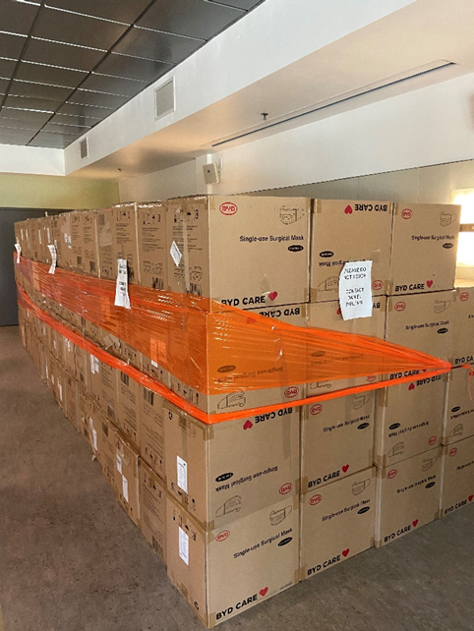
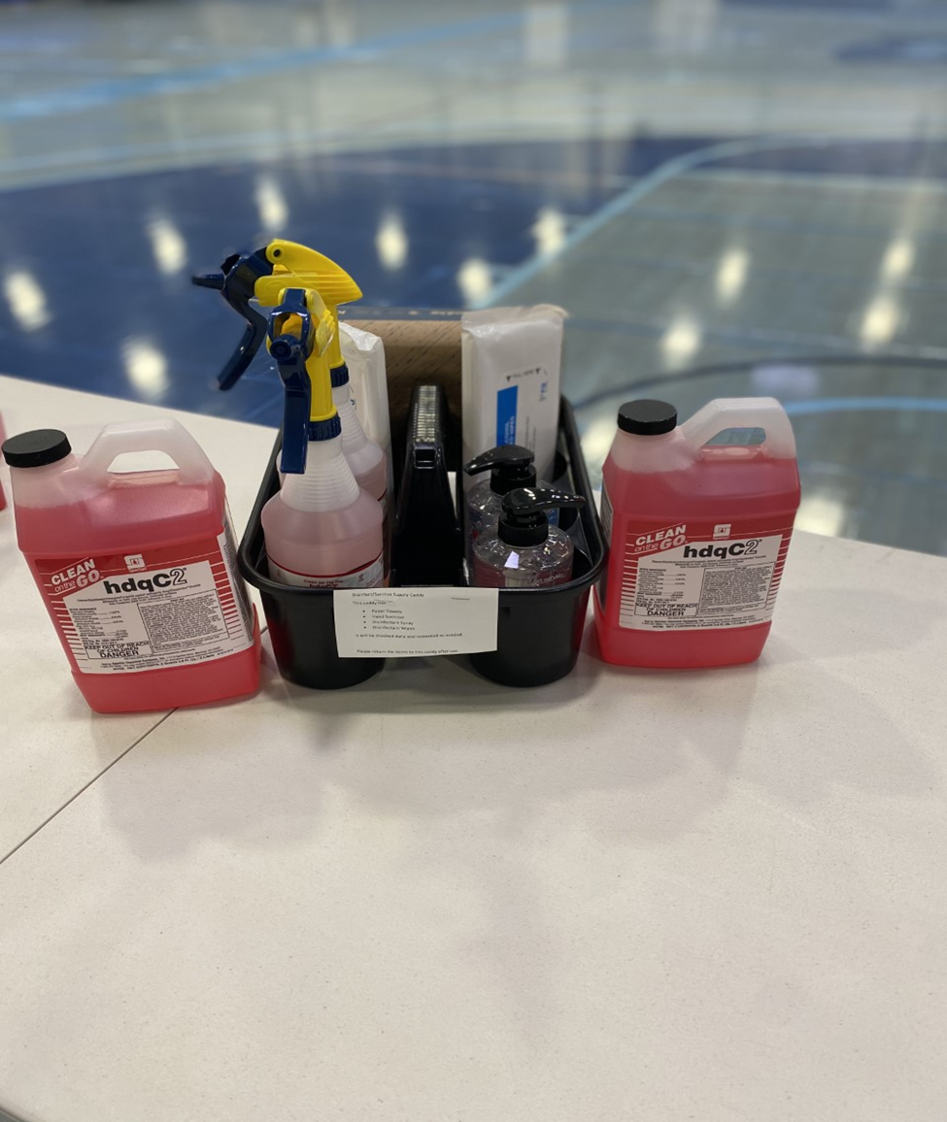

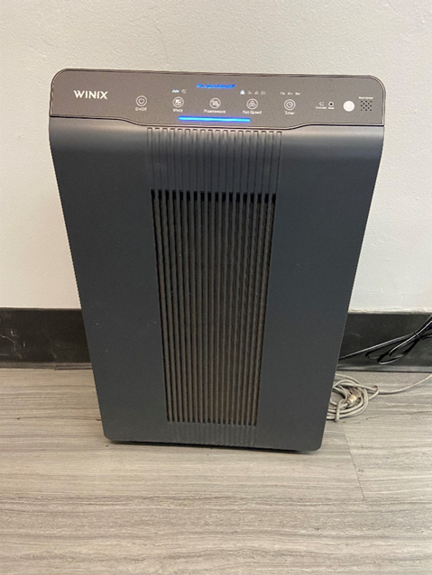
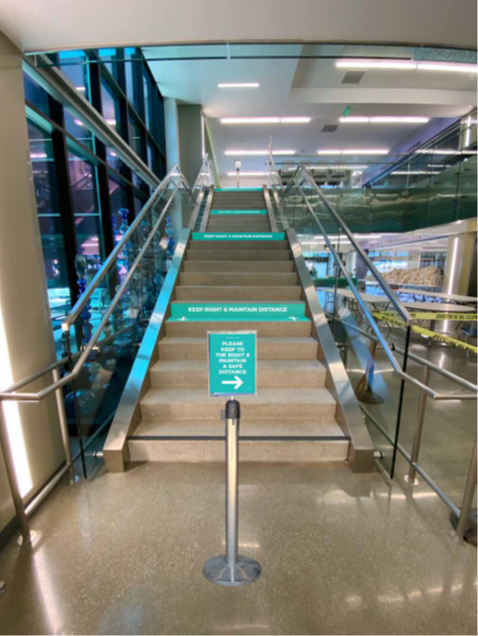
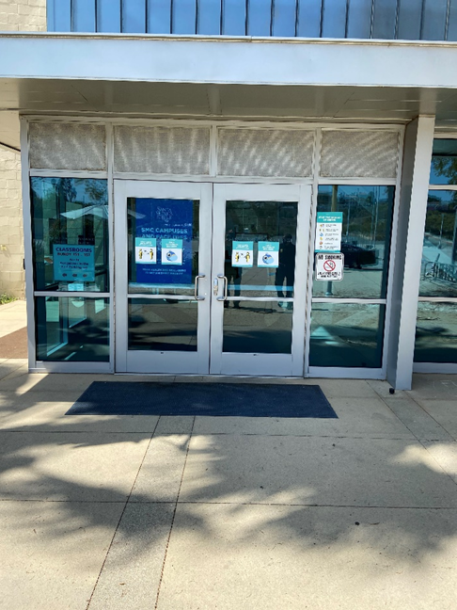
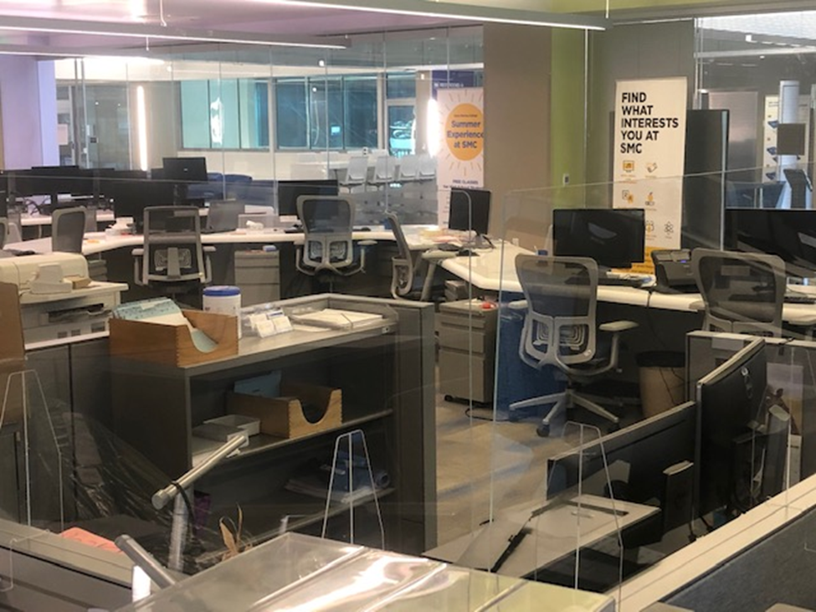
  Prepare for Return To Campus
    As of April 14, 2021 inventory of 1,566,330 of Personal Protective Equipment and Supplies

Slide 23
  Backfill Lost Revenue
    Actual Loss 2019-20 = $7,837,997
    Projected Loss 2020-2021 = $14,532,269
    Projected Loss 2021-2022 = $17,825,765
    Total: $40,196,030

Slide 25
2020-2021 Third Quarter Budget Update

Slide 26
Things WILL Change
May Revise by May 14th
  Current Year Deficit Factor
    Adopted Budget: 0.85% or <$1,176,604>
    P1: 2.3826% or <$3,283,013>
  Promising YTD Revenue
    PIT: $12.78 B above forecast YTD
    SU Tax: $760 M above forecast YTD
    Corp: $721 M above forecast YTD

Slide 27
Projected Changes in Revenue 2020-2021 Adopted Budget to Third Quarter Projections
2020-2021 Adopted Budget | $177,477,796
HEERF Revenue Backfill for 19-20 and 20-21 | 16,349,241
Prior Year Adjustment | 711,260
Student Fees | -150,000
Apportionment Deficit Factor | -2,106,409
Other | -49,672
2020-2021 Third Quarter Revenue Projection | $192,232,216
Increase in revenue of $14,754,420 or 8.3%

Slide 28
Projected Changes in Expenditures 2020-2021 Adopted Budget to Third Quarter Projections
2020-2021 Adopted Budget | $185,235,757
Early End of Furloughs and Salary Freezes | 982,064
Hourly Instruction and Non-instruction | 226,046
Cost of TRANS Borrowing | -233,190
Health and Welfare and Retirement | -289,939
Utilities and Insurance | -417,190
Vacancy List | -616,421
Supplies and Contracts | -722,036
Other | 4,193
2020-2021 Third Quarter Revenue Projection | $184,179,284
Decrease in expenditures of $1,056,473 or 0.57%

Slide 29
2020-2021 Fund Balance
 | Adopted Budget | Third Quarter
Beg. Fund Balance: | 21,040,755 | 21,040,755
Adj. Beg. Balance: | - | 298,334
Ongoing Revenue: | 166,284,936 | 167,178,838
Ongoing Expenditure: | 184,080,918 | 182,683,861
Operating/Structural Surplus/Deficit: | <17,795,982> | <15,505,023>
One-time Items: | 10,038,022 | 7,208,714
One-time HEERF: | - | 16,349,241
Surplus/Deficit w/ One-time Items: | <7,757,960> | 8,052,932
Ending Fund Balance: | 13,282,795 | 29,392,021
FB to Total Expenditure and Transfer: | 7.17% | 15.96%

Slide 30
  Key Take Aways
    May Revise could change things
    Structural Deficit is at a record high
      Non-resident Tuition decline is historic
      Hold harmless ends June 30, 2024 - <$11,275,890>
      HEERF funds are one-time and a “band aid”
    Fund balance is not a sign of financial stability due to one-time funds!

Slide 31
    Special Thank You To…
    Veronica Diaz and the Budget Team
    John Greenlee, Charlie Yen
    and the Facilities Planning Team
    Kim Tran, Irma Haro and the Accounting Team
    The Budget Committee

Slide 32

Questions

